Slide 1


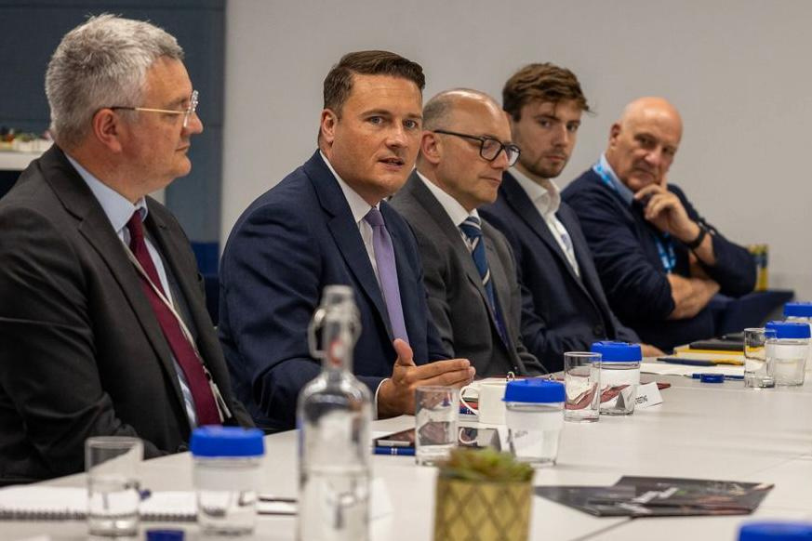
The Ten Year Health Plan
Partner Toolkit
July 2025

Slide 2
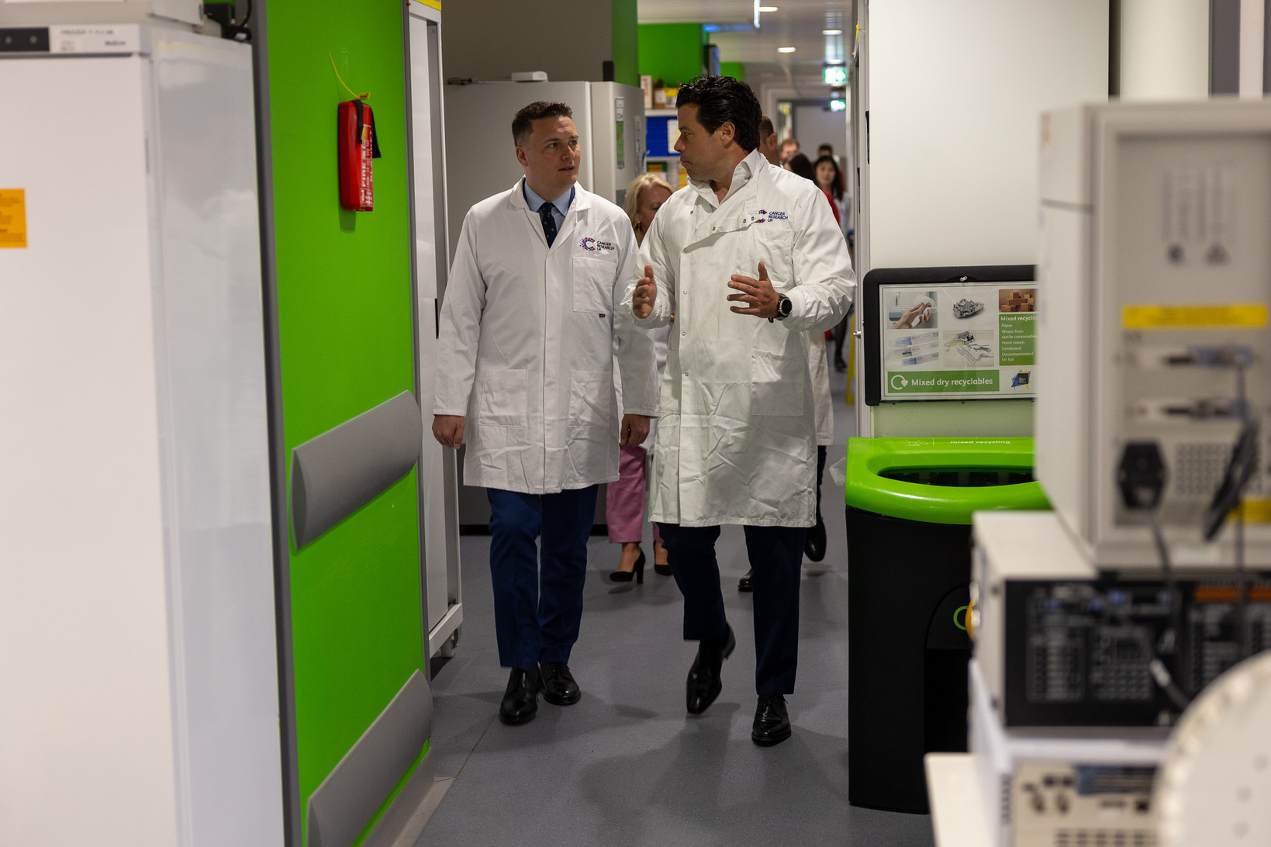
Overview
Alongside over 270,000 insights from health staff and the public, 1,600 organisations have contributed to the development of the 10 Year Health Plan since October 2024. This 10 Year Health Plan will get the NHS back on its feet and make it fit for the future.
The plan is backed with an extra £29 billion investment.
It will deliver three transformational shifts in how the NHS works:
From hospital to community - bringing healthcare directly to peoples’ doorsteps and homes and making treatment more accessible and convenient.
From analogue to digital - harnessing technology to free healthcare staff from administrative burdens, while simplifying appointment bookings and health management.
From sickness to prevention - reaching patients earlier, to catch illness before it spreads and prevent it in the first place and by making the healthy choice the easy choice.

Slide 3
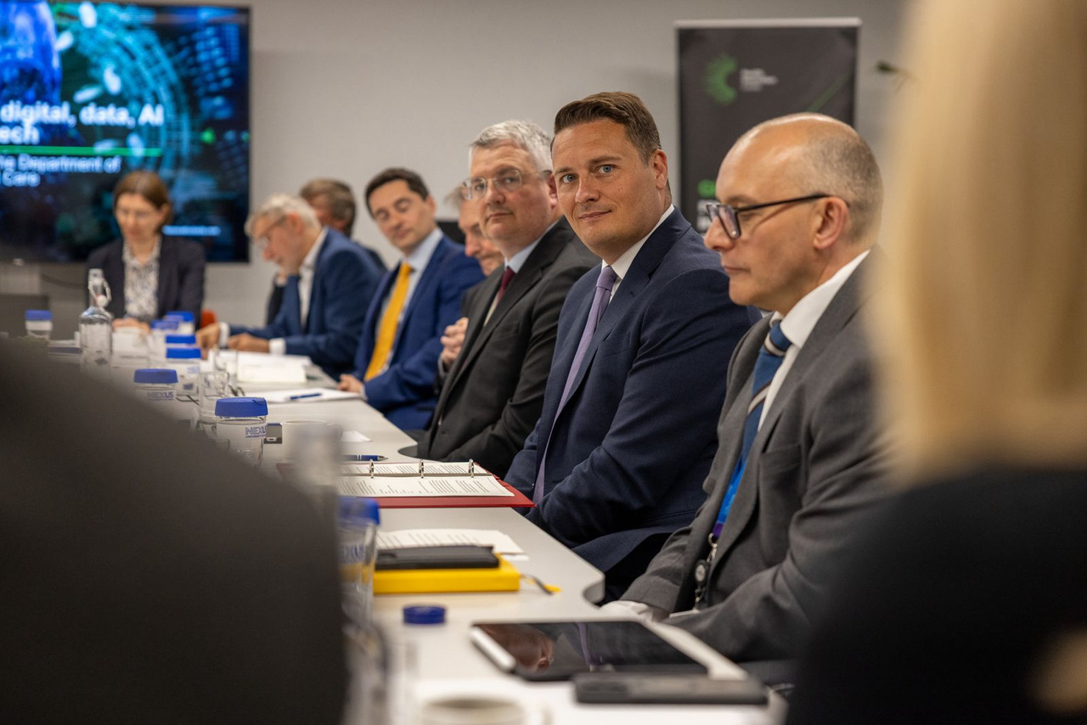

10 Year Health Plan
This is the 10 year plan to get the NHS back on its feet and to make it fit for the future, delivered through three big shifts.
From hospital to community; transforming healthcare to improve access to GPs and dentists, bringing services together into neighbourhood health centres, enabling quicker specialist referrals, convenient prescriptions, and round-the-clock mental health support - all designed to bring quality care closer to home.
From analogue to digital; creating a seamless healthcare experience through digital innovation, with a single patient record accessible to patients and staff, AI-enhanced doctor services and specialist self-referrals via the NHS app, a digital red book for children's health information, and online booking that ensures equitable NHS access nationwide.
The Ten Year Health Plan seizes the opportunities provided by new technology, medicines, and innovation to deliver better care for all patients - no matter where they live or how much they earn - and better value for taxpayers.
From sickness to prevention; shifting to preventative healthcare by making healthy choices easier—banning energy drinks for under-16s, offering new weight loss services, introducing home screening kits, and providing financial support to low-income families. All to catch illness earlier.
At the same time, unnecessary bureaucracy will be cut, to give more power and resources to the frontline, giving staff more time to care.

Slide 4
What does the Plan mean for people by 2028/29?
HOSPITAL TO COMMUNITY
Restore GP access.
A GP led Neighbourhood Health Service with teams organised around groups with most need.
Care closer to the community - Neighbourhood Health Centres in every community; increased pharmacy services and more NHS dentists.
Redesigning outpatient and diagnostic services.
Redesigning urgent and emergency care self-booking for urgent care services and Mental Health Emergency Departments co-located or close to 50% existing Type 1 A&E units (over the next 5 years).
ANALOGUE TO DIGITAL
NHS App will be the front door to the NHS.
‘HealthStore’ to access approved health apps - enabling innovative SMEs to work more collaboratively with the NHS and regulators.
Single Patient Record - More coordinated, personalised and predictive care. It will improve clinical outcomes, make decision-making more informed and speed up the delivery of care.
Digital liberation for staff - Scale proven technology quickly, to boost clinical productivity.
SICKNESS TO PREVENTION
Smoking - Tobacco and Vapes Bill.
Obesity and physical activity – update school food standards and reduce junk food advertising.
Alcohol - support to make healthier choices with more information on health risks.
Helping our children to flourish - expand Mental Health Support Teams.
Employment and work - local NHS service targets for reducing unemployment and economic inactivity.
Improve vaccination, screening and early diagnosis - create a new genomics population health service.

Slide 5
What does the Plan mean for staff?
A Workforce Plan - Plans for training, education and retention.
Staff Standards - Developing minimum standards for modern NHS employment with the Social Partnership Forum.
Self-sufficient workforce (by 2035) - Encouraging the NHS to employ and develop domestic labour and reducing dependence on international labour to less than 10% of new recruits.
Prioritise UK graduates for training (by 2035) - UK medical graduates and other doctors who have worked in the NHS for a significant period given priority for foundation and specialty training.
Starting a conversation on contractual reform (by 2035) - Work with trade unions and employers to maintain, update and reform employment contracts.
Recruiting more locally (by 2035) - New duties on NHS employers to consider how they use the local labour market and act as a growth generator.
Curricula review (by 2030) - Ask regulators to review curricula to ensure the workforce have the right skills for the future.

Slide 6

The 10 Year Health Plan has been launched.
Swipe to see how the government is building an NHS fit for the future by making care easier, bringing services closer to you and using technology to transform healthcare 👇
PM launches new era for NHS with easier care in neighbourhoods - GOV.UK
Social media carousel and copy

Slide 7
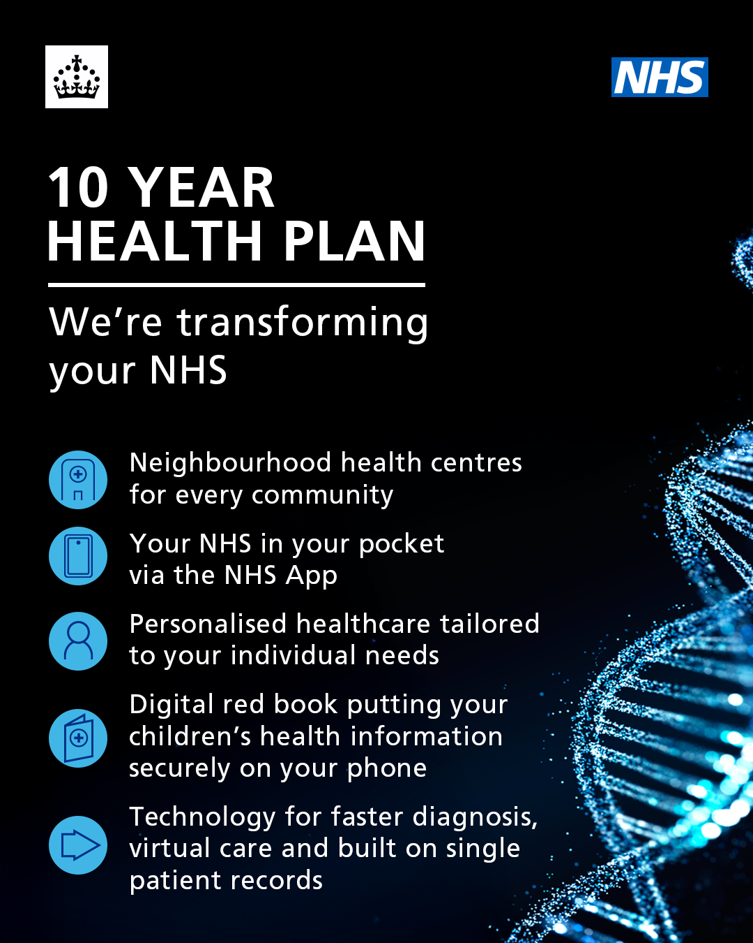
Social media graphic and copy
The 10 Year Health Plan has been launched.
The government is building an NHS fit for the future by making care easier, bringing services closer to you and using technology to transform healthcare.
Learn more: PM launches new era for NHS with easier care in neighbourhoods - GOV.UK

Slide 8



Get involved: Your channels
Boost DHSC messages: Stay up to date by following and tagging DHSC on social media. Share the latest news and encourage your network to engage in the conversation.
Social media posts: Emphasise the importance of the 10 Year Health Plan. This could be through blog posts, vlogs, or LinkedIn articles on the plan.
Your own channels: Use your newsletters and website to share how the 10 Year Health Plan will benefit your supporters, members and campaigners.
Please contact dhscexternalaffairs@dhsc.gov.uk if you would like support for your communications activity.

Slide 9



Get involved: Wider media output
Case studies: If you - or organisations in your networks - have case studies that highlight how patients and/or staff are already benefitting from NHS transformation, we'd love to hear them.
Immediate Media support: Provide a statement that highlights the significance of the 10 Year Health Plan to relevant media outlets for future announcements.
Op-eds: Write your own op-eds for media outlets, highlighting the benefits of the plan for your sector. Do get in touch if you’d like to explore a joint op-ed with DHSC.
Please contact dhscexternalaffairs@dhsc.gov.uk if you would like support for your communications activity.

Slide 10





Share and promote
@DHSCgovuk
@dhscgovuk
Department of Health and Social Care
@dhscgovuk

Slide 11
Where to find out more
10 Year Health Plan: 10 Year Health Plan for England: fit for the future - GOV.UK
Press Notice: PM launches new era for NHS with easier care in neighbourhoods - GOV.UK
Easy Read Executive Summary: 10 Year Health Plan for England: fit for the future (easy read) - GOV.UK

Slide 12
We listened…
GETTING THE CARE YOU NEED
People told us:
Access to GP and dental care is a struggle.
Waits for ambulances, A&E and essential treatment are too long.
The 10 Year Health Plan delivers:
An end to the 8am phone queue - with thousands more GPs and a transformed NHS app.
Better dental access – with new dentists to serve NHS patients first.
Faster emergency care - allowing pre-booking through the NHS App or 111.
Care closer to home - through a new Neighbourhood Health Service.
SICKNESS TO PREVENTION
People told us:
The NHS should focus more on preventing illness and addressing the causes of poor health.
More support is needed for mental health and healthy lifestyles.
The 10 Year Health Plan sets out how we will:
Invest in local health services with personalised care.
Expand school mental health support.
Increase access to free and healthier school meals.
Create the first smoke-free generation.
Improve the healthiness of food sales.
Use scientific breakthroughs to develop, gene-tailored preventative treatments.
Invest in life-saving vaccine research.
GREAT PLACE TO WORK
People told us:
NHS staff are overworked, undervalued, and burdened by bureaucracy.
The 10 Year Health Plan sets out how we will:
Set new standards for flexible, modern NHS employment.
Expand training with 2,000 more nursing apprenticeships and 1,000 postgraduate posts.
Cut unnecessary mandatory training.
Empower local leadership and reduce top-down micromanagement.
Digitise records and use AI to reduce admin burden.
SEAMLESS HEALTHCARE
People told us:
They have to repeat their medical history too often and travel extensively between appointments.
NHS departments operate in isolation rather than as a coordinated service.
The 10 Year Health Plan delivers:
A single patient record - giving people control while ensuring every healthcare professional has their complete information.
Care built around people via integrated healthcare teams working together in communities.
FIXING THE BASICS
People told us:
NHS systems are outdated, inefficient and time consuming.
The 10 Year Health Plan sets out how we will:
Upgrade IT so staff spend more time with patients.
Enable appointment booking and health management on the NHS App.
Ensure systems talk to each other.

Slide 13
Stay in touch
If you have questions or would like to support with your communication's activity contact:
  DHSC External Affairs team: dhscexternalaffairs@dhsc.gov.uk
  NHSE External Affairs team: england.nhs.stakeholderengagement@nhs.net
Sign up to our DHSC External Affairs weekly bulletin: DHSC External Affairs Bulletin Subscription Page

